Slide 1
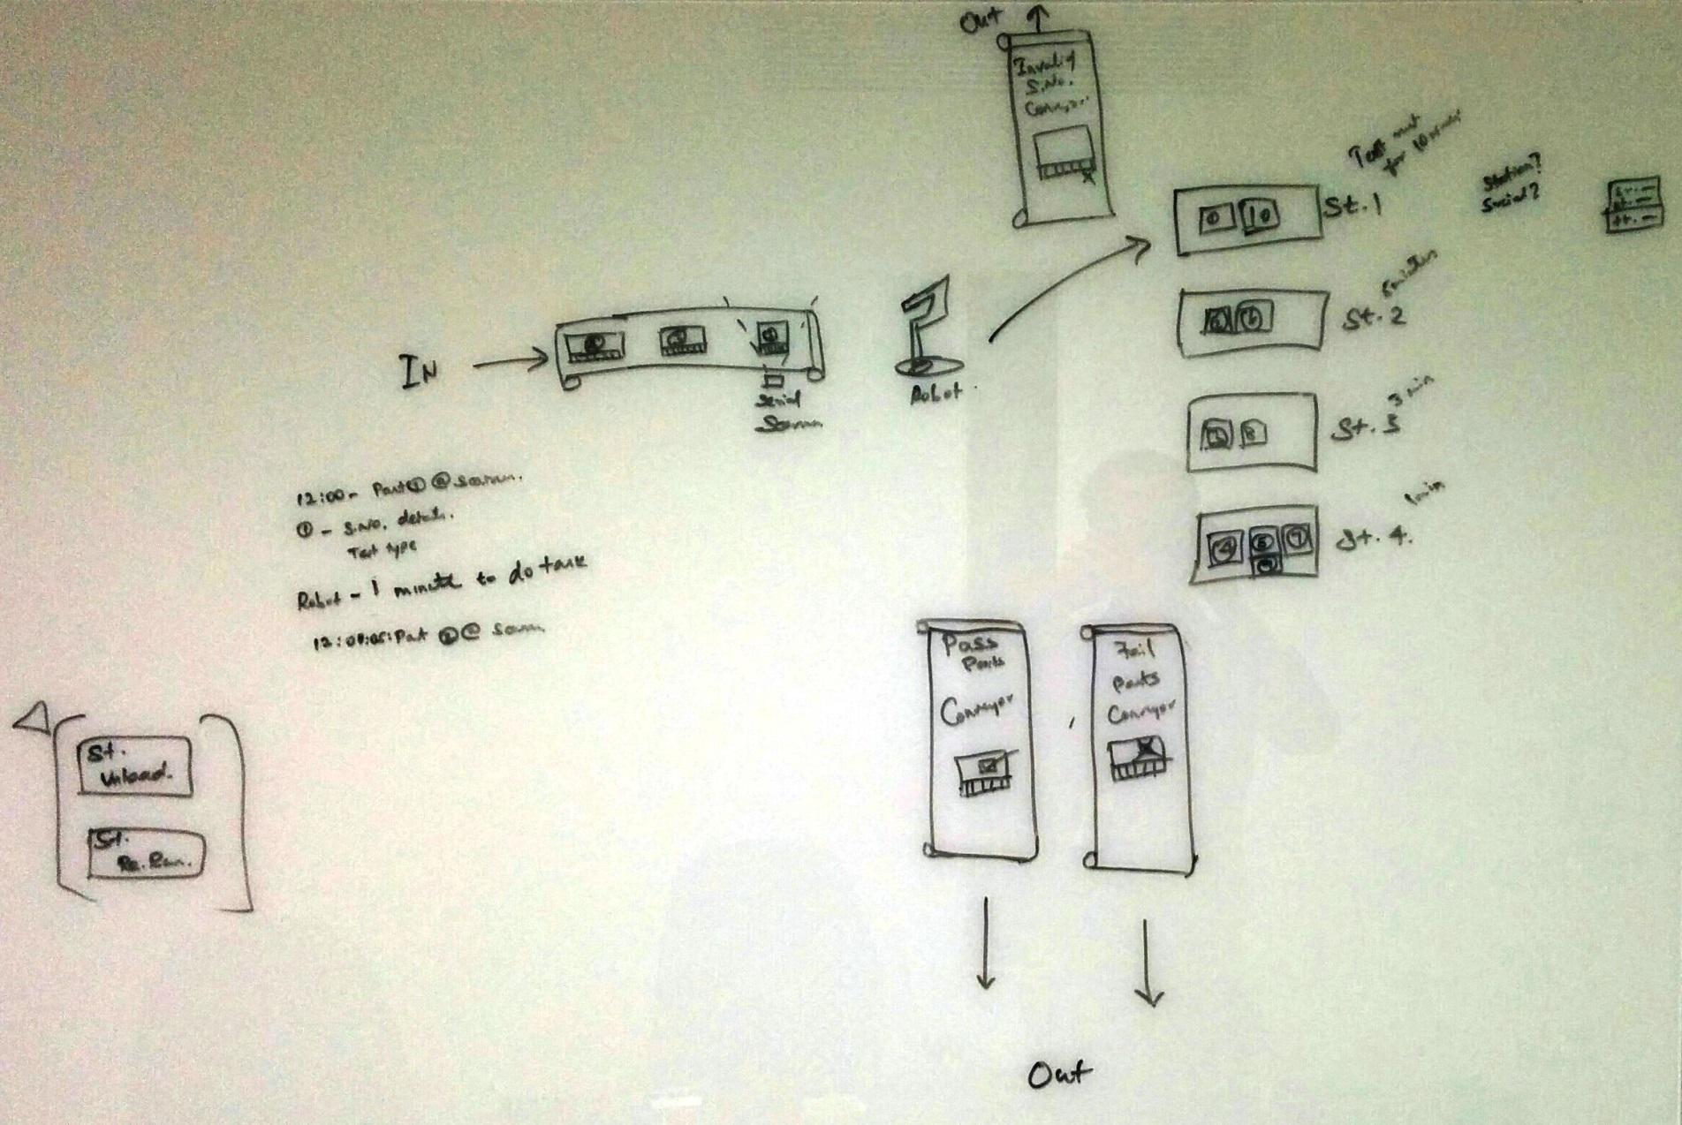
System Diagram

Slide 2
System Setup
2 scanners for Auto mode & 1 scanner for manual mode
1 input conveyor where serials comes in.
After test, serials can go away either of
Pass serial conveyor
Fail serial conveyor
Invalid serial conveyor
Only one robot exists and the availability of the robot is based on the tasks from PC.
Four test stations exists for testing four serials in parallel.
Air Leak Test Instrument, Model-E from ATC is used for testing purpose.

Slide 3
Existing ALT Setup
START (Manual)
Result DB
ALT Instrument
STOP (Manual)
CLAMP
PASS
DAQ
PC
FAIL
Test
Running
Test Result DB
IDLE
PASS
FAIL
Pressure, Flow
Test Result, Test Time

Slide 4
New ALT Requirement
Result SQL DB
ALT Instrument
Read Tag:
Robot_Available
Start_Test
Stop_Test
Scan_Trigger
Station_No_Start_Stop_Test
Barcode Scanner
CLAMP
PASS
RS Linx PLC
(Robot)
PC
DAQ
FAIL
Test Select
TTA
TTB
Write Tag:
Task_Available_for_Robot
New_Serial
Serial_Adapter_Plate_Size
Serial_Displacement_Size
Serial_Flange_Size
Test_Result
Station_Number
Rerun
Invalid_SNo
PC_ACK_Read_Tags
FAIL
Serial Detail SQL DB
Test Result MDB DB
PASS
Test
Running
IDLE
Flange, Displacement,
Adapterplate, Test Type.
Pressure, Flow
Test Result, Test Time

Slide 5
Read Tags - Data (from Robot to LabVIEW)
Robot_Available
1 = Robot Available
0 = Robot Unavailable
Start_Test
1 = Start Test
0 = Nothing
Stop_Test
1 = Stop Test
0 = Nothing
Station_No_Start_Stop_Test
0 = Station-1
1 = Station-2
2 = Station-3
3 = Station-4
Scan_Trigger
0 = Scan Trigger (Serial available @ scanner location)
1 = No trigger

Slide 6
Write Tags – Data (from LabVIEW to Robot)
Task_Available_for_Robot
1 = Task Available for Robot
0 = Nothing
New_Serial
1 = New Serial Task
0 = Nothing
Serial_Adapter_Plate_Size
Numeric data type from DB
Serial_Displacement_Size
Numeric data type from DB
Serial_Flange_Size
String data type from DB
Test_Result
1 = PASS
0 = FAIL
Station_Number
0 = Station-1
1 = Station-2
2 = Station-3
3 = Station-4
Rerun
1 = Rerun (TRUE)
0 = No Rerun
Invalid_SNo
1 = Invalid Serial Number at Scanner
0 = Valid Serial Number
PC_ACK_Read_Tags
1 = PC has read the tags from Robot
0 = PC has NOT read the tags

Slide 7
Expected PC Behaviour
PC remembers the station occupancy and intimate robot to
which station to load the new serial (or)
which station to unload the serial (or)
which station to rerun the serial.
PC sends new serial details (Displacement/Flange/Adapter sizes) when new and valid serial is available at the scanner.
PC directly controls the sets the test type to run in the various ALT stations using SELECT line in ALT instrument.
PC scans for the new serial after getting Scan_Trigger from PLC. PC will read both the scanners and uses only the valid serial number from the scanners for further processing.
PC sends the rerun command to Robot and wait for Start_Test signal from robot to rerun the test. Number of rerun allowed is controlled by the INI entry.
PC sends the New_Serial tag & Invalid_Serial_Number tag to intimate the arrival of serial at scanner stage which has no DB entry.
Work order number will be used from INI entry.
Start/Stop button used in existing system will not work for Auto mode. In manual mode, test can be started or stopped as is in existing system.
PC reads the tags from Robot and sets the PC_ACK_Read_Tags to 1 (True). Robot should send the next signal only after this acknowledgement. Robot should reset this PC_ACK_Read_Tags to 0 (False) before sending next tag.
PS: INI file location: C:\Soliton Projects\EATON\ALTS-2015\Software\Info\ALTS-2015.ini

Slide 8
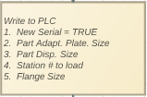



Expected Robot Behaviour
Robot should identify NEW SERIAL to load in the station using New_Serial tag.
Robot should identify INVALID serial number using New_Serial tag & Invalid_Serial_Number tag.
Robot should identify the serial RERUN by using New_Serial tag, Rerun and Station_Number tag.
Robot should identify the UNLOAD by using New_Serial tag, Test_Result tag and Station_Number tag. Robot should move the unloaded part to respective conveyor based on Test_Resut tag.

Slide 9
Expected Robot Behaviour -Continuation
Robot should identify the task available for it to execute using the tag Task_Available_for_Robot
While doing any task, robot should indicate its unavailability by setting Robot_Available to 0 (False/Unavailable). When robot is free to take up any task, it should indicate its availability by setting Robot_Available to 1 (True/Available)
Should act accordingly to Test result and rerun command. If rerun is true, robot should send the start signal again for the specific station.
Robot should send Scan_Trigger when a new part is available at the scanner location.
After loading the serial in the station, robot should send Start_Test along with the station number in Station_No_Start_Stop_Test tag.
Similarly to Stop Test in-progress, robot should send Stop_Test along with the station number in Station_No_Start_Stop_Test tag.
PC reads the tags from Robot and sets the PC_ACK_Read_Tags to 1 (True). Robot should send the next signal only after this acknowledgement. Robot should reset this PC_ACK_Read_Tags to 0 (False) before sending next tag.

Slide 10
Clarifications
In existing ALTS, work order number is part of the result written to the SQL Server database. You mentioned that we won’t have work order numbers for the new system. What do we write to the database in lieu of work order number? Do you have to write anything at all? Maybe we should call to have a conversation on this
-use constant for now from.
If the part fails air leak test, we will re-run the test. How many times can you re-run the test? I am assuming that we log the results for all runs in the SQL database (we need to check if there is a timestamp parameter when writing results to the database to distinguish between the different runs). I believe we agreed on 1 retest (Mike please confirm). We do log results for all runs. Maybe we should get together to check that parameter; I’m not sure where to check that…

Slide 11
More Questions
What are the emergency stop signals? How the STOP signal in the existing system is handled?
Result-DB and Serial-Details-DB uses the same DSN (EPSN_NEW.dsn)? i.e., same DB? If different, please mention.

Slide 12
Validation required while integration.
Store procedure of Serial-Detail DB (aka AirLeakLookup store procedure)

Slide 13
Anish To validate
Software design document – light 1, 2, 3 is correct according to DAQ connection. Previous ALTS design document has extra light indicator in it.

Slide 14
Error Occurrences
Error 91 – Data type error. Occurs usally if datasocket server is not initalized in simulation mode. In practical, it should occur if the datasocket communication is missing.

Slide 15
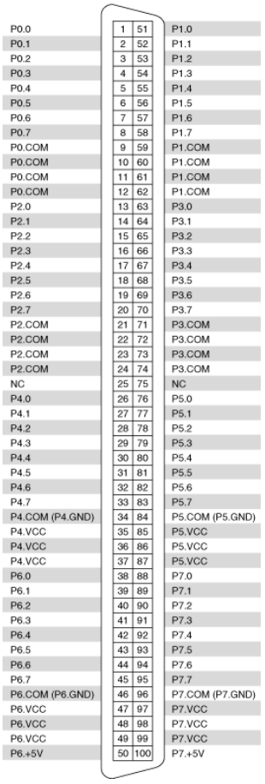
New ALTS - Pinout Configurations
Station1_TTA – P0.5 – PIN 6
Station2_TTA – P1.5 – PIN 56
Station1_TTB – P0.6 – PIN 7
Station2_TTB – P1.6 – PIN 57
Station3_TTA – P2.5 – PIN 18
Station4_TTA – P3.5 – PIN 68
Station3_TTB – P2.6 – PIN 19
Station4_TTB – P3.6 – PIN 69
Station1_Select_Test – P4.6 – PIN 32
Station2_Select_Test – P5.6 – PIN 82
Station3_Select_Test – P6.6 – PIN 44
Station4_Select_Test – P7.6 – PIN 94

Slide 16
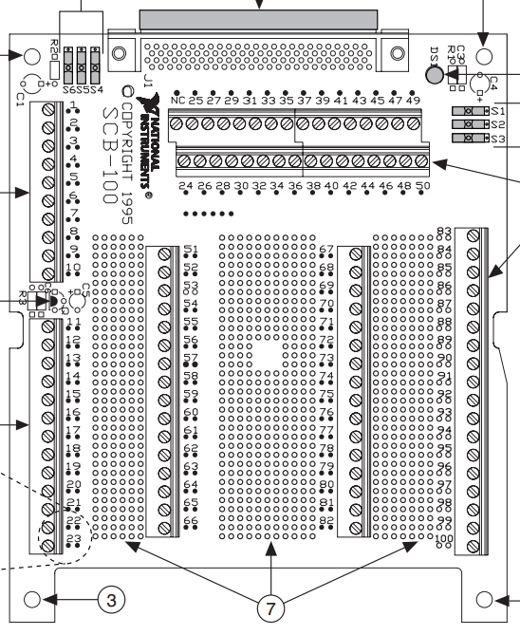
Station3_Select_Test – P6.6 – PIN 44
Station1_Select_Test – P4.6 – PIN 32
Terminal connectors are not equal to the printed numbers
Station1_TTB – P0.6 – PIN 7
Station1_TTA – P0.5 – PIN 6
Station4_TTA – P3.5 – PIN 68
Station4_TTB – P3.6 – PIN 69
Station2_TTA – P1.5 – PIN 56
Station2_TTB – P1.6 – PIN 57
Station4_Select_Test – P7.6 – PIN 94
Station3_TTA – P2.5 – PIN 18
Station3_TTB – P2.6 – PIN 19
Station2_Select_Test – P5.6 – PIN 82

Slide 17
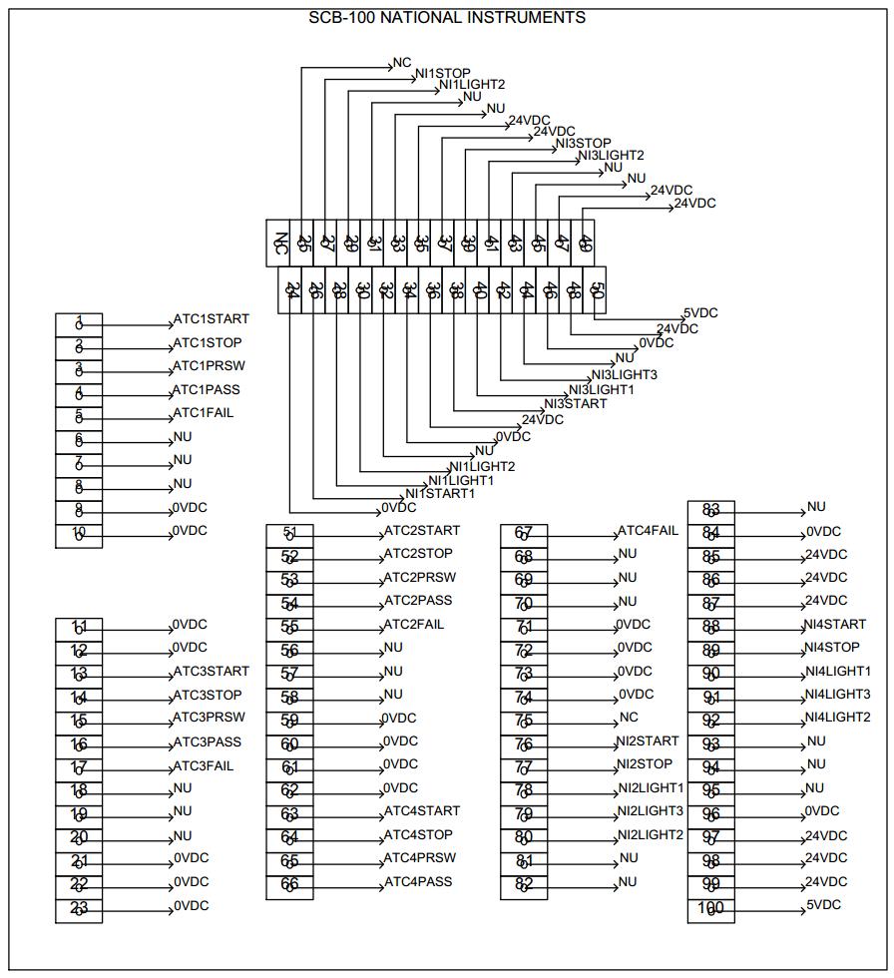
Station3_Select_Test – P6.6 – PIN 44
Station1_TTA – P0.5 – PIN 6
Station1_Select_Test – P4.6 – PIN 32
Station1_TTB – P0.6 – PIN 7
Station4_TTA – P3.5 – PIN 68
Station4_TTB – P3.6 – PIN 69
Station2_TTA – P1.5 – PIN 56
Station2_TTB – P1.6 – PIN 57
Station4_Select_Test – P7.6 – PIN 94
Station3_TTA – P2.5 – PIN 18
Station3_TTB – P2.6 – PIN 19
Station2_Select_Test – P5.6 – PIN 82

Slide 19
Authentication Screen
Air Leak Test Screen
DAQ Engine
INI File Management Module
Leak Test Instrument Result Reading Module
Result DB Communication Module
Serial Details Communication Module
MS Access DB
SQL Server DB (EPSN)
DI Engine
DO Engine
INI File data

